Slide 1
Computer Networks & Internet
Prepared by
Risala Tasin Khan

Slide 2
What’s the Internet: “nuts and bolts” view
The nuts and bolts of Internet means the basic hardware and software components that make up the Internet.
Internet is a worldwide computer network that interconnects millions of computing devices throughout the world.
Not too long ago, these computing devices were primarily traditional desktop PCs, printers and servers.
Now Web cams and even toasters are being connected to the Internet.
In the Internet jargon, all of these devices are called hosts or end system.
End systems are connected together by communication links.

Slide 3




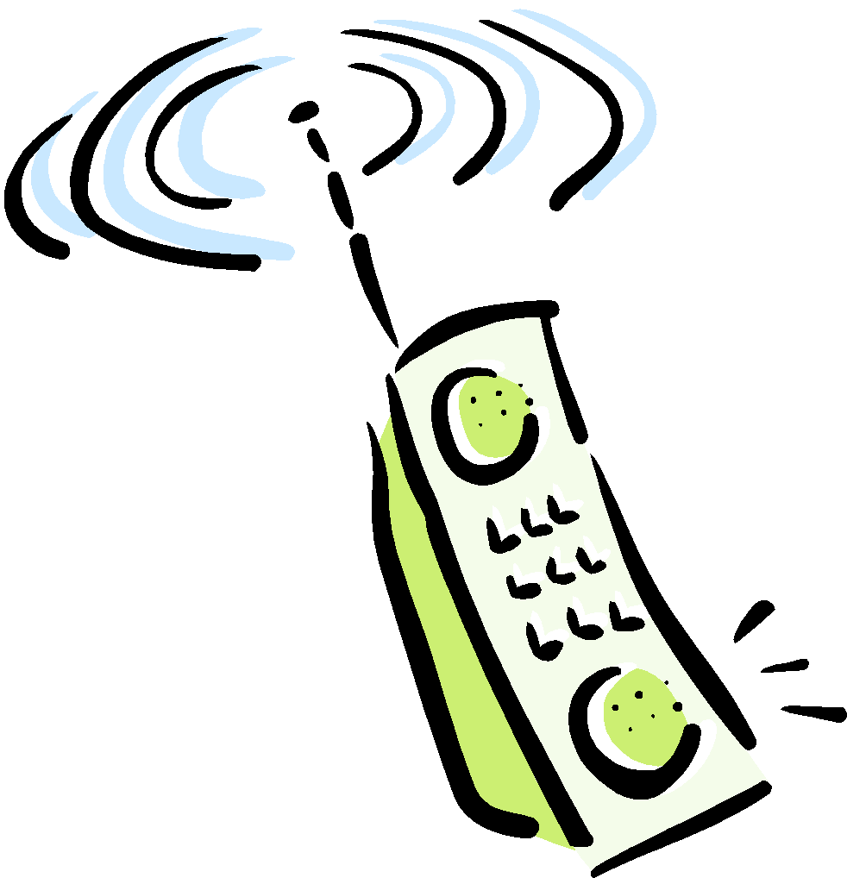

What’s the Internet: “nuts and bolts” view
millions of connected computing devices: hosts = end systems
running network apps
communication links
fiber, copper, radio, satellite
transmission rate = bandwidth
routers: forward packets (chunks of data)
router
workstation
server
mobile
local ISP
regional ISP
company
network

Slide 4
Some Basic Terms
Packet Switch:
A packet switch takes a chunk of information arriving on one of its incoming communication links and forwards that chunk of information on one of its outgoing communication links. The chunk of information is called packet.
Packet switching comes in many shapes and flavors but the two most prominent types are routers and link-layer switches.
Internet Service Provider (ISPs):
End systems access the Internet through ISPs including residential ISPs such as AOL or local telephone or cable company; corporate ISPs; university ISPs and ISPs such as T-Mobile that provide wireless access in airports, hotels, coffee shops etc.
Local ISP's are connected to regional ISPs, which are in turn connected to national and international ISPs. The national and international ISPs are connected together at the highest tier in the hierarchy.
router
workstation
server
mobile
local ISP
regional ISP
company
network

Slide 5
Internet: A Service Description
The Internet allows distributed applications running on its end systems to exchange data with each other.
These applications include remote login, file transfer, electronic mail, audio and video streaming, real-time audio and video conferencing, distributed games, the World Wide Web, and much more
It is worth emphasizing that the Web is not a separate network but rather just one of many distributed applications that use the communication services provided by the Internet. The Web could also run over a network besides the Internet.
The Internet provides two services to its distributed applications: a connection-oriented service and a connectionless service.
Currently the Internet does not provide a service that makes promises about how long it will take to deliver the data from sender to receiver. And except for increasing your access bit rate to your Internet Service Provider (ISP), you currently cannot obtain better service (e.g., shorter delays) by paying more

Slide 6
What’s a protocol?
human protocols:
“what’s the time?”
“I have a question”
introductions
… specific msgs sent
… specific actions taken when msgs received, or other events
network protocols:
machines rather than humans
all communication activity in Internet governed by protocols
protocols define format, order of msgs sent and received among network entities, and actions taken on msg transmission, receipt

Slide 7



What’s a protocol?
a human protocol and a computer network protocol:
Hi
TCP connection
request
Hi
TCP connection
response
Got the
time?
Get http://www.awl.com/kurose-ross
2:00
<file>
time
Q: Other human protocols?

Slide 8
The Network Edge
End systems, Clients and Server:
In computer networking jargon, the computers that we use on a daily basis are often referred to as hosts or end systems. They are referred to as "hosts" because they host (run) application-level programs such as a Web browser or server program, or an e-mail program.
Hosts are sometimes further divided into two categories: clients and servers.
Informally, clients often tend to be desktop PC's or workstations, while servers are more powerful machines.
But there is a more precise meaning of a client and a server in computer networking. In the so-called client-server model, a client program running on one end system requests and receives information from a server running on another end system.
Since a client typically runs on one computer and the server runs on another computer, client-server Internet applications are, by definition, distributed applications. The client and the server interact with each other by communicating (i.e., sending each other messages) over the Internet.

Slide 9






The network edge:
end systems (hosts):
run application programs
e.g. Web, email
at “edge of network”
client/server model
client host requests, receives service from always-on server
e.g. Web browser/server; email client/server
peer-peer model:
minimal (or no) use of dedicated servers
e.g. Skype, BitTorrent, KaZaA

Slide 10
Network edge: connection-oriented service
TCP service [RFC 793]
reliable, in-order byte-stream data transfer
loss: acknowledgements and retransmissions
flow control:
sender won’t overwhelm receiver
congestion control:
senders “slow down sending rate” when network congested
Goal: data transfer between end systems
handshaking: setup (prepare for) data transfer ahead of time
Hello, hello back human protocol
set up “state” in two communicating hosts
TCP - Transmission Control Protocol
Internet’s connection-oriented service

Slide 11
Network edge: connectionless service
Goal: data transfer between end systems
same as before!
UDP - User Datagram Protocol [RFC 768]:
connectionless
unreliable data transfer
no flow control
no congestion control
App’s using TCP:
HTTP (Web), FTP (file transfer), Telnet (remote login), SMTP (email)
App’s using UDP:
streaming media, teleconferencing, DNS, Internet telephony

Slide 12
The Network Core
mesh of interconnected routers
the fundamental question:
how is data transferred through net?
circuit switching: dedicated circuit per call: telephone net
packet-switching: data sent through net in discrete “chunks”

Slide 13



Network Core: Circuit Switching
End-end resources reserved for “call”
dedicated resources: no sharing
call setup required
circuit-like (guaranteed) performance
same path for all chunks

Slide 14
Network Core: Circuit Switching
network resources (e.g., bandwidth) divided into “pieces”
allocated pieces per call
no sharing
resource piece idle if not used by owning call

Slide 15
Multiplexing in Circuit-Switched Network
A circuit in a link is implemented with either frequency division multiplexing (FDM) or time-division multiplexing (TDM).
With FDM, the frequency spectrum of a link is shared among the connections established across the link. Specifically, the link dedicates a frequency band to each connection for the duration of the connection.
In telephone networks, this frequency band typically has a width of 4 kHz. The width of the band is called the bandwidth. FM radio stations also use FDM to share microwave frequency spectrum
For a TDM link, time is divided into frames of fixed duration and each frame is divided into a fixed number of time slots. When the network establish a connection across a link, the network dedicates one time slot in every frame to the connection. These slots are dedicated for the sole use of that connection, with a time slot available for use (in every frame) to transmit the connection's data.

Slide 16
Circuit Switching: FDM and TDM
Example:
FDM
4 users
frequency
time
TDM
frequency
time
Notes:
Two simple multiple access control techniques.
Each mobile’s share of the bandwidth is divided into portions for the uplink and the downlink. Also, possibly, out of band signaling.
As we will see, used in AMPS, GSM, IS-54/136

Slide 17

Network Core: Packet Switching
100 Mb/s
Ethernet
A
C
1.5 Mb/s
B
each end-to-end data stream is divided into packets
no dedication/reservation: all streams share resources
no setup is required
resources used as needed
each packet uses full link bandwidth
aggregate resource demand can exceed capacity
no guarantee

Slide 18
Network Core: statistical multiplexing
100 Mb/s
Ethernet
A
C
statistical multiplexing
1.5 Mb/s
B
queue of packets
waiting for output
link
D
E
Sequence of A & B packets does not have fixed pattern, shared on demand ➔ statistical multiplexing.
Whereas in TDM, each host gets same slot (periodically)

Slide 19
Packet switching versus circuit switching
A
Circuit switching
2 circuits (use TDM)
A reserves 1 circuit
B reserves 1 circuit
2 Mb/s
B
Utilization = 50% only = 1 Mb/s
B: has no
packets to send
A
Packet switching
statistical multiplex.
B uses full link since
A is not using it
2 Mb/s
B
Utilization = 100% = 2 Mb/s

Slide 20
Packet Switching: Store & Forward
Most packet switches use store-and-forward transmission at the inputs to the links.
Store-and-forward transmission means that the packet switch must receive the entire packet before it can begin to transmit the first bit of the packet onto the outbound link.
To explore store-and-forward transmission in more detail, consider a simple network consisting of two end systems connected by a single router,
A router will typically have many incident links, since its job is to switch an incoming packet onto an outgoing link; in this simple example, the router has the rather simple task of transferring a packet from one (input) link to the only other attached link.

Slide 21
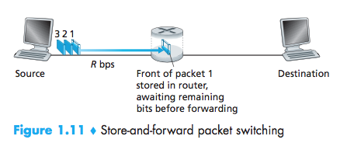
Cont…
In this example, the source has three packets, each consisting of L bits, to send to the destination.
At the snapshot of time shown in Figure 1.11, the source has transmitted some of packet 1, and the front of packet 1 has already arrived at the router.
Because the router employs store-and-forwarding, at this instant of time, the router cannot transmit the bits it has received; instead it must first buffer (i.e., “store”) the packet’s bits.
Only after the router has received all of the packet’s bits can it begin to transmit (i.e., “forward”) the packet onto the outbound link.

Slide 22
Cont….
let’s now calculate the amount of time that elapses from when the source begins to send the packet until the destination has received the entire packet.
The source begins to transmit at time 0; at time L/R seconds, the source has transmitted the entire packet, and the entire packet has been received and stored at the router (since there is no propagation delay).
At time L/R seconds, since the router has just received the entire packet, it can begin to transmit the packet onto the outbound link towards the destination;
At time 2L/R, the router has transmitted the entire packet, and the entire packet has been received by the destination. Thus, the total delay is 2L/R.

Slide 23
Cont…
Now let’s calculate the amount of time that elapses from when the source begins to send the first packet until the destination has received all three packets.
As before, at time L/R, the router begins to forward the first packet. But also at time L/R the source will begin to send the second packet, since it has just finished sending the entire first packet.
Thus, at time 2L/R, the destination has received the first packet and the router has received the second packet.
Similarly, at time 3L/R, the destination has received the first two packets and the router has received the third packet.
Finally, at time 4L/R the destination has received all three packets!
In general, the delay can be written as:
D_{end-to-end} = N (L/R)

Slide 24
Packet switching versus circuit switching
Packet-switching Circuit-switching
Resources sharing dedicated
Congestion may lead to it admission control
Overhead less overhead; more overhead;
no connection setup reserve resources 1st
Guarantee Best-effort provide guarantee
no guarantee good for multimedia

Slide 25
Queuing Delays and Packet Loss
Each packet switch has multiple links attached to it.
For each attached link, the packet switch has an output buffer (also called an output queue), which stores packets that the router is about to send into that link.
If an arriving packet needs to be transmitted onto a link but finds the link busy with the transmission of another packet, the arriving packet must wait in the output buffer.
Thus, in addition to the store-and-forward delays, packets suffer output buffer queuing delays.
These delays are variable and depend on the level of congestion in the network.
Since the amount of buffer space is finite, an arriving packet may find that the buffer is completely full with other packets waiting for transmission.
In this case, packet loss will occur—either the arriving packet or one of the already-queued packets will be dropped

Slide 26
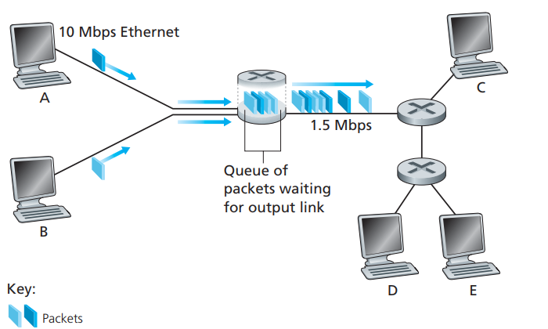
Queuing Delay
Suppose Hosts A and B are sending packets to Host E.
Hosts A and B first send their packets along 10 Mbps Ethernet links to the first router.
The router then directs these packets to the 1.5 Mbps link.
If, during a short interval of time, the arrival rate of packets to the router (when converted to bits per second) exceeds 1.5 Mbps, congestion will occur at the router as packets queue in the link’s output buffer before being transmitted onto the link.

Slide 27








Access networks and physical media
Q: How to connect end systems to edge router?
residential access nets
institutional access networks (school, company)
mobile access networks
Keep in mind:
bandwidth (bits per second) of access network?
shared or dedicated?

Slide 28
Residential access: point to point access
Residential access refers to connecting a home end system to an edge router.
Today, the two most prevalent types of broadband residential access are digital subscriber line (DSL) and cable.
A residence typically obtains DSL Internet access from the same local telephone company (telco) that provides its wired local phone access.
Thus, when DSL is used, a customer’s telco is also its ISP.
each customer’s DSL modem uses the existing telephone line (twisted pair copper wire) to exchange data with a digital subscriber line access multiplexer (DSLAM) located in the telco’s local central office (CO).
The home’s DSL modem takes digital data and translates it to high frequency tones for transmission over telephone wires to the CO

Slide 29
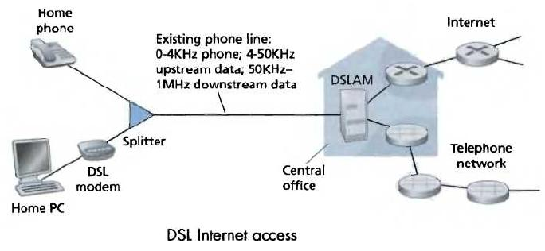
Residential access: point to point access
The residential telephone line carries both data and traditional telephone signals simultaneously, which are encoded at different frequencies:
up to 1 Mbps upstream (today typically < 256 kbps)
up to 8 Mbps downstream (today typically < 1 Mbps)
FDM:
50 kHz - 1 MHz for downstream
4 kHz - 50 kHz for upstream
0 kHz - 4 kHz for ordinary telephone

Slide 30
Cont….
This approach makes the single DSL link appear as if there were three separate links, so that a telephone call and an Internet connection can share the DSL link at the same time.
On the customer side, a splitter separates the data and telephone signals arriving to the home and forwards the data signal to the DSL modem.
On the telco side, in the CO, the DSLAM separates the data and phone signals and sends the data into the Internet.
Hundreds or even thousands of households connect to a single DSLAM
Because the downstream and upstream rates are different, the access is said to be asymmetric.

Slide 31
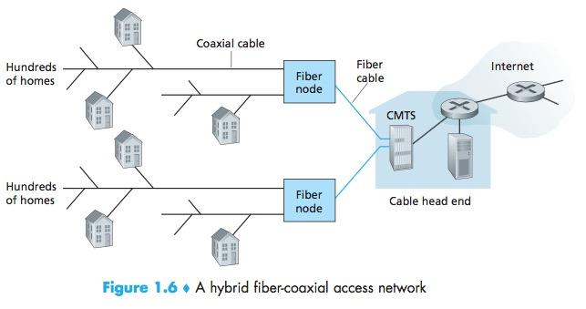
Residential access: cable modems
Cable Internet access makes use of the cable television company’s existing cable television infrastructure.
A residence obtains cable Internet access from the same company that provides its cable television.
As shown in the fig., fiber optics connect the cable head end to neighborhood-level junctions, from which traditional coaxial cable is then used to reach individual houses and apartments.
Each neighborhood junction typically supports 500 to 5,000 homes.
Because both fiber and coaxial cable are employed in this system, it is often referred to as hybrid fiber coax (HFC).

Slide 32
Cont…
Cable internet access requires special modems, called cable modems.
The cable modem is typically an external device and connects to the home PC through an Ethernet port.
At the cable head end, the cable modem termination system (CMTS) serves a similar function as the DSL network’s DSLAM—turning the analog signal sent from the cable modems in many downstream homes back into digital format.
Cable modems divide the HFC network into two channels, a downstream and an upstream channel.
As with DSL, access is typically asymmetric, with the downstream channel typically allocated a higher transmission rate than the upstream channel.
The DOCSIS 2.0 standard defines downstream rates up to 42.8 Mbps and upstream rates of up to 30.7 Mbps.

Slide 33
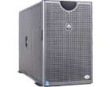

Cable Network Architecture: Overview
server(s)
cable headend
cable distribution
network
home

Slide 34
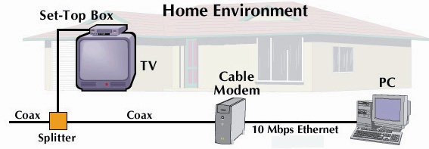
Cable Network Architecture: Overview
cable headend
cable distribution
network (simplified)
home

Slide 35
Cable Network Architecture: Overview
FDM:
C
O
N
T
R
O
L
V
I
D
E
O
V
I
D
E
O
V
I
D
E
O
V
I
D
E
O
V
I
D
E
O
V
I
D
E
O
D
A
T
A
D
A
T
A
1
2
3
4
5
6
7
8
9
Channels
cable headend
cable distribution
network
home

Slide 36
Cont…
One important characteristic of cable Internet access is that it is a shared broadcast medium.
In particular, every packet sent by the head end travels downstream on every link to every home and every packet sent by a home travels on the upstream channel to the head end.
For this reason, if several users are simultaneously downloading a video file on the downstream channel, the actual rate at which each user receives its video file will be significantly lower than the aggregate cable downstream rate.
On the other hand, if there are only a few active users and they are all Web surfing, then each of the users may actually receive Web pages at the full cable downstream rate, because the users will rarely request a Web page at exactly the same time.

Slide 37



Home networks
Typical home network components:
ADSL or cable modem
router/firewall/NAT
Ethernet
wireless access
point
wireless
laptops
to/from
cable
headend
cable
modem
router/
firewall
wireless
access
point
Ethernet

Slide 38
Fiber-To-The-Home (FTTH)
Fiber optics can offer significantly higher transmission rates than twisted-pair copper wire or coaxial cable.
Recently some local ISP provides optical fiber connection from their CO to the home.
The simplest optical distribution network is called direct fiber,for which there is one fiber leaving the CO for each home.
Such distribution can provide high bandwidth, since each customer gets its own dedicated connection.

Slide 39
Access in the Enterprise (and the Home): Ethernet and WiFi
On corporate and university campuses, and increasingly in home settings, a local area network (LAN) is used to connect an end system to the edge router.
Although there are many types of LAN technologies, Ethernet is by far the most prevalent access technology in corporate, university, and home networks.
Ethernet users use twisted-pair copper wire to connect to an Ethernet switch
The Ethernet switch, or a network of such interconnected switches, is then in turn connected into the larger Internet.
With Ethernet access, users typically have 100 Mbps access to the Ethernet switch, whereas servers may have 1 Gbps or even 10 Gbps access.

Slide 40
Cont…
Increasingly, however, people are accessing the Internet wirelessly from laptops, smartphones, tablets, and other devices.
In a wireless LAN setting, wireless users transmit/receive packets to/from an access point that is connected into the enterprise’s network (most likely including wired Ethernet), which in turn is connected to the wired Internet.
A wireless LAN user must typically be within a few tens of meters of the access point.
Wireless LAN access based on IEEE 802.11 technology, more colloquially known as WiFi, is now just about everywhere—universities, business offices, cafes, airports, homes, and even in airplanes.

Slide 41
Overview of Delay in Packet-Switched Networks
As a packet travels from one node (host or router) to the subsequent node (host or router) along this path, the packet suffers from several types of delays at each node along the path.
The most important of these delays are the nodal processing delay, queuing delay, transmission delay, and propagation delay; together, these delays accumulate to give a total nodal delay

Slide 42
Processing Delay
The time required to examine the packet’s header and determine where to direct the packet is part of the processing delay.
The processing delay can also include other factors, such as the time needed to check for bit-level errors in the packet that occurred in transmitting the packet’s bits from the upstream node to router A.
Processing delays in high-speed routers are typically on the order of microseconds or less.

Slide 43
Queuing Delay
At the queue, the packet experiences a queuing delay as it waits to be transmitted onto the link.
The length of the queuing delay of a specific packet will depend on the number of earlier-arriving packets that are queued and waiting for transmission onto the link.
If the queue is empty and no other packet is currently being transmitted, then our packet’s queuing delay will be zero.
On the other hand, if the traffic is heavy and many other packets are also waiting to be transmitted, the queuing delay will be long.

Slide 44
Transmission Delay
Assuming that packets are transmitted in a first-come-first-served manner, our packet can be transmitted only after all the packets that have arrived before it have been transmitted.
Denote the length of the packet by L bits, and denote the transmission rate of the link from router A to router B by R bits/sec.
For example, for a 10 Mbps Ethernet link, the rate is R = 10 Mbps; for a 100 Mbps Ethernet link, the rate is R = 100 Mbps.
The transmission delay is L/R. This is the amount of time required to push (that is, transmit) all of the packet’s bits into the link.
Transmission delays are typically on the order of microseconds to milliseconds in practice.

Slide 45
Propagation Delay
Once a bit is pushed into the link, it needs to propagate to router B.
The time required to propagate from the beginning of the link to router B is the propagation delay.
The bit propagates at the propagation speed of the link.
The propagation speed depends on the physical medium
The propagation delay is the distance between two routers divided by the propagation speed.
That is, the propagation delay is d/s, where d is the distance between router A and router B and s is the propagation speed of the link.

Slide 46

Nodal delay
d_{proc} = processing delay
typically a few microsecs or less
d_{queue} = queuing delay
depends on congestion
d_{trans} = transmission delay
= L/R, significant for low-speed links
d_{prop} = propagation delay
a few microsecs to hundreds of msecs

Slide 47
Queuing Delay and Packet Loss
The most complicated and interesting component of nodal delay is the queuing delay, d_{queue}.
if 10 packets arrive at an empty queue at the same time, the first packet transmitted will suffer no queuing delay, while the last packet transmitted will suffer a relatively large queuing delay (while it waits for the other nine packets to be transmitted).
Therefore, when characterizing queuing delay, one typically uses statistical measures, such as average queuing delay, variance of queuing delay, and the probability that the queuing delay exceeds some specified value.
When is the queuing delay large and when is it insignificant?
The answer to this question depends on the rate at which traffic arrives at the queue, the transmission rate of the link, and the nature of the arriving traffic, that is, whether the traffic arrives periodically or arrives in bursts.

Slide 48
Cont…
let a denote the average rate at which packets arrive at the queue (a is in units of packets/sec). R is the transmission rate. Also suppose, for simplicity, that all packets consist of L bits.
Then the average rate at which bits arrive at the queue is La bits/sec.
Finally, assume that the queue is very big, so that it can hold essentially an infinite number of bits.
The ratio La/R, called the traffic intensity, often plays an important role in estimating the extent of the queuing delay.
If La/R > 1, then the average rate at which bits arrive at the queue exceeds the rate at which the bits can be transmitted from the queue.
In this unfortunate situation, the queue will tend to increase without bound and the queuing delay will approach infinity!
Therefore, one of the golden rules in traffic engineering is: Design your system so that the traffic intensity is no greater than 1.

Slide 49
Cont…
Now consider the case La/R ≤ 1.
Here, the nature of the arriving traffic impacts the queuing delay.
For example, if packets arrive periodically—that is, one packet arrives every L/R seconds—then every packet will arrive at an empty queue and there will be no queuing delay.
On the other hand, if packets arrive in bursts but periodically, there can be a significant average queuing delay.
For example, suppose N packets arrive simultaneously every (L/R)N seconds. Then the first packet transmitted has no queuing delay; the second packet transmitted has a queuing delay of L/R seconds; and more generally, the nth packet transmitted has a queuing delay of (n 1)L/R seconds.
.

Slide 50
Cont…
Typically, the arrival process to a queue is random; that is, the arrivals do not follow any pattern and the packets are spaced apart by random amounts of time.
In this more realistic case, the quantity La/R is not usually sufficient to fully characterize the queueing delay statistics.
In particular, if the traffic intensity is close to zero, then packet arrivals are few and far between and it is unlikely that an arriving packet will find another packet in the queue. Hence, the average queuing delay will be close to zero.
On the other hand, when the traffic intensity is close to 1, there will be intervals of time when the arrival rate exceeds the transmission capacity (due to variations in packet arrival rate), and a queue will form during these periods of time; when the arrival rate is less than the transmission capacity, the length of the queue will shrink.
Nonetheless, as the traffic intensity approaches 1, the average queue length gets larger and larger

Slide 51
Packet Loss
Because the queue capacity is finite, packet delays do not really approach infinity as the traffic intensity approaches 1.
Instead, a packet can arrive to find a full queue. With no place to store such a packet, a router will drop that packet; that is, the packet will be lost.
From an end-system viewpoint, a packet loss will look like a packet having been transmitted into the network core but never emerging from the network at the destination.
The fraction of lost packets increases as the traffic intensity increases. Therefore, performance at a node is often measured not only in terms of delay, but also in terms of the probability of packet loss.

Slide 52
Throughput
Another critical performance measure in computer networks is end-to-end throughput.
To define throughput, consider transferring a large file from Host A to Host B across a computer network. This transfer might be, for example, a large video clip from one peer to another in a P2P file sharing system. The instantaneous throughput at any instant of time is the rate (in bits/sec) at which Host B is receiving the file.
If the file consists of F bits and the transfer takes T seconds for Host B to receive all F bits, then the average throughput of the file transfer is F/T bits/sec.

Slide 53
Example
Consider two end systems, a server and a client, connected by two communication links and a router.
Let Rs denote the rate of the link between the server and the router; and Rc denote the rate of the link between the router and the client.
Suppose that the only bits being sent in the entire network are those from the server to the client.
We now ask, in this ideal scenario, what is the server- to-client throughput?
To answer this question, we may think of bits as fluid and communication links as pipes. Clearly, the server cannot pump bits through its link at a rate faster than Rs bps; and the router cannot forward bits at a rate faster than Rc bps.
If Rs < Rc, then the bits pumped by the server will “flow” right through the router and arrive at the client at a rate of Rs bps, giving a throughput of Rs bps.
If, on the other hand, Rc < Rs , then the router will not be able to forward bits as quickly as it receives them. In this case, bits will only leave the router at rate Rc , giving an end-to-end throughput of Rc.
Note also that if bits continue to arrive at the router at rate Rs , and continue to leave the router at Rc , the backlog of bits at the router waiting for transmission to the client will grow and grow—a most undesirable situation!

Slide 54
Networks Under Attack

Slide 55
The bad guys can put malware into your host via the Internet
We attach devices to the Internet because we want to receive/send data from/to the Internet.
This includes all kinds of good stuff, including Web pages, e-mail messages, MP3s, telephone calls, live video, search engine results, and so on.
But, unfortunately, along with all that good stuff comes malicious stuff—collectively known as malware—that can also enter and infect our devices.
Once malware infects our device it can do all kinds of devious things, including deleting our files; installing spyware that collects our private information, such as social security numbers, passwords, and keystrokes, and then sends this (over the Internet) back to the bad guys.
Our compromised host may also be enrolled in a network of thousands of similarly compromised devices, collectively known as a botnet, which the bad guys control and leverage for spam email distribution or distributed denial-of-service attacks against targeted hosts

Slide 56
Cont…
Much of the malware out there today is self-replicating: once it infects one host, from that host it seeks entry into other hosts over the Internet, and from the newly infected hosts, it seeks entry into yet more hosts. In this manner, self replicating malware can spread exponentially fast.
Malware can spread in the form of a virus or a worm.
Viruses are malware that require some form of user interaction to infect the user’s device. The classic example is an e-mail attachment containing malicious executable code. If a user receives and opens such an attachment, the user inadvertently runs the malware on the device. Typically, such email viruses are self-replicating: once executed, the virus may send an identical message with an identical malicious attachment to, for example, every recipient in the user’s address book.
Worms are malware that can enter a device without any explicit user interaction. For example, a user may be running a vulnerable network application to which an attacker can send malware. In some cases, without any user intervention, the application may accept the malware from the Internet and run it, creating a worm. The worm in the newly infected device then scans the Internet, searching for other hosts running the same vulnerable network application. When it finds other vulnerable hosts, it sends a copy of itself to those hosts

Slide 57
The bad guys can attack servers and network infrastructure
Another broad class of security threats are known as denial-of-service (DoS) attacks.
Internet DoS attacks are extremely common, with thousands of DoS attacks occurring every year.
Most Internet DoS attacks fall into one of three categories:
• Vulnerability attack.: This involves sending a few well-crafted messages to a vulnerable application or operating system running on a targeted host. If the right sequence of packets is sent to a vulnerable application or operating system, the service can stop or, worse, the host can crash.
• Bandwidth flooding: The attacker sends a deluge of packets to the targeted host—so many packets that the target’s access link becomes clogged, preventing legitimate packets from reaching the server.
• Connection flooding: The attacker establishes a large number of half-open or fully open TCP connections at the target host. The host can become so bogged down with these bogus connections that it stops accepting legitimate connections.

Slide 58
The bad guys can sniff packets
Many users today access the Internet via wireless devices, such as WiFi-connected laptops or handheld devices with cellular Internet connections.
While global Internet access is extremely convenient and enables marvelous new applications for mobile users, it also creates a major security vulnerability—by placing a passive receiver in the vicinity of the wireless transmitter, that receiver can obtain a copy of every packet that is transmitted!
These packets can contain all kinds of sensitive information, including passwords, social security numbers, trade secrets, and private personal messages.
A passive receiver that records a copy of every packet that flies by is called a packet sniffer.
Sniffers can be deployed in wired environments as well. In wired broadcast environments, as in many Ethernet LANs, a packet sniffer can obtain copies of broadcast packets sent over the LAN.
Furthermore, a bad guy who gains access to an institution’s access router or access link to the Internet may be able to plant a sniffer that makes a copy of every packet going to/from the organization. Sniffed packets can then be analyzed offline for sensitive information.

